Slide 1

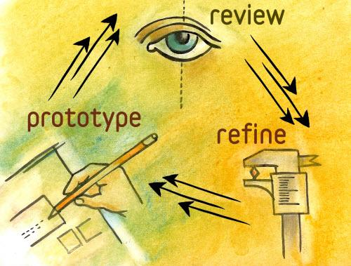
PROTOTYPE
CS577a Fall 2014
WE ARE TROJANS (WAT) NETWORK
Team #1
@Copyright 2014
Notes:
Title
A platform that aims to enhance the Trojan Network. We Are Trojans network uses a point system as an incentive for trojans to actively utilize the system
Image From: http://www.stepbystep.com/wp-content/uploads/2013/05/How-to-Evaluate-a-Software-Companys-Prototype.jpg

Slide 2
Agenda
Introduction to We are Trojans (WAT) Network
Tools and Technology
Prototype
UI
WAT Point System
Lessons Learned
Next Step
@Copyright 2014
Notes:
Title

Slide 3

@Copyright 2014
Introduction to We are Trojans (WAT) Network
Notes:
Deni

Slide 4

Background
“We Are Trojans (WAT) Network” is an online collaboration platform that will:
Bring Trojans together and reward those who contribute positively to the community.
Make the benefits of the Trojan family more visible.
@Copyright 2014
Notes:
Image from: http://icommakimberly.tumblr.com/post/37460885263/adorbs

Slide 5

@Copyright 2014
Tools and Technology
Notes:
Deni
Image: http://nonprofitanswerguide.org/ask/integrate-technology-into-nonprofit-and-tools-available/

Slide 6



Tools and Technology
@Copyright 2014
Notes:
Deni

Slide 7
@Copyright 2014
Prototype
Notes:
Saloni

Slide 8
Prototypes
Evolutionary Prototyping via UI Design
An algorithmic approach to solve an issue relating to the core capability
@Copyright 2014
Notes:
Saloni

Slide 9
1st Risk Prototype - User Interface
Why
How to mitigate the risk?
Using Buying information methodology
Demonstrate the UI visually
Get feedback from the client
How to mitigate the risk?
Using Buying information methodology
Demonstrate the UI visually
Get feedback from the client
No concrete requirements of the UI
Need feedback from the clients
@Copyright 2014
Need to enhance the team’s understanding of the UI
Notes:
Saloni
Why?
The client has specified that he wants a web-based application for the project. In Win-Win session the key features for the application were discussed, but the organization of the features on an actual web-page were unclear.
UI being the integral part if the system, we need to mitigate this risk.
How to Mitigate this Risk?
Methodology used to Mitigate this risk is Buying Information. Prototyping this feature will enable us to get feedback from the clients, and evolve the user-interface for the system.
The prototype demonstrate a static view of the actual webpage, that could be shown to the receive his approval. The visual will give the client a way to see how requirements/features will be presented on web-page. With this a win-win negotiations session could be establish to finalize the UI

Slide 10
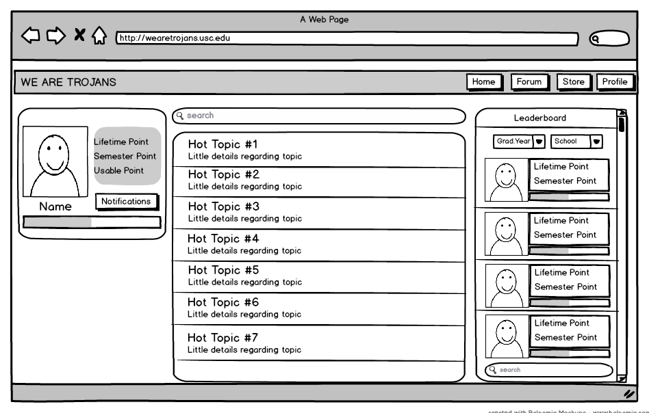
Home-Page
Client Requirements:
(UI should have)
• Leaderboard
• User Profile
• Main menu
• Search Option
• Notifications
• Experience Level
@Copyright 2014
Notes:
Suleyman

Slide 11
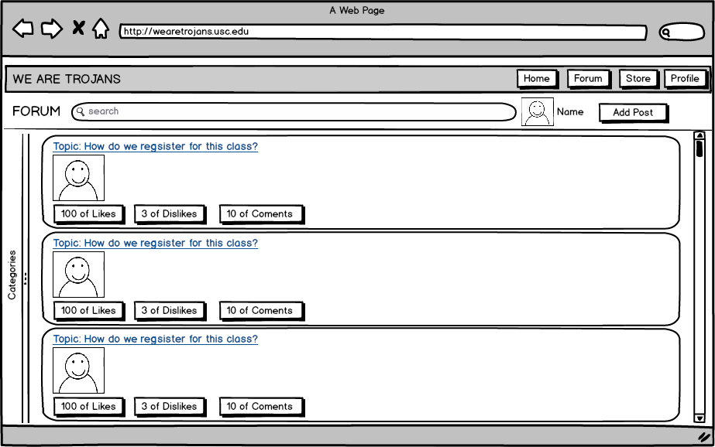
Forum-Page
Client Requirements:
(UI should have)
• Categorization (collapsible,
will only show when click)
• Like Functionality
• Dislike Functionality
• Search Option
• Main Menu
@Copyright 2014
Notes:
Suleyman
Talk about like/dislike, redeem points

Slide 12
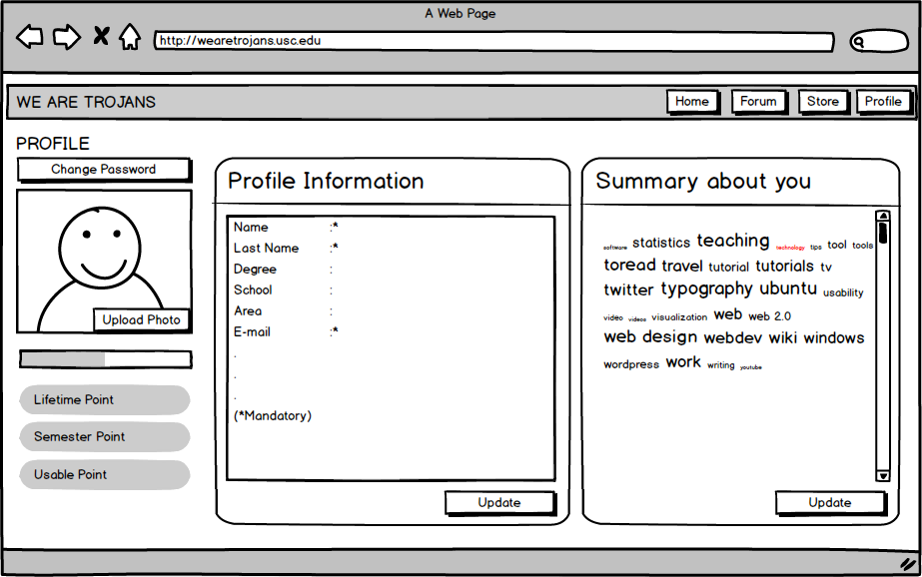
Profile-Page
Client Requirements:
(UI should have)
• Update Profile Functionality
• Personal Wall
(to post status / summary)
• Experience Level
• Main menu
@Copyright 2014
Notes:
Suleyman

Slide 13
2nd Risk Prototype - WAT Points system
How to mitigate the risk?
Formalize rules of the points system
Get Feedback from the client
Develop prototype early to address further risk.
Why
Crucial feature of the system
Determine feasibility of the proposed points system
@Copyright 2014
Create mutual understanding among team members
Notes:
Golf
Why
Important to the system
empower the those features of the systems
because these will improve our understanding toward the project
How
come up with the formula of the points system to make the point system more understandable
Create diagrams to provide mutual understanding among all stakeholders

Slide 14
Points system(WAT Points) overview
Each user has 3 different points
Total points (TPoint)
Accumulated lifetime points of a user
Purpose of this point: Identify the credibility of the user
Semester points (SPoint)
Reset every semester
Purpose of this point: Compete with other user in the system
Current points (CPoint) or Usable points
Redeem items from gifts store.
@Copyright 2014
Notes:
Golf
total points
stick with the user account for a live time
provide credibility of the users
semester
reset every semester
provide competitive environment as some users will not feel left behind
usable points
redeem items or gift card from the store

Slide 15
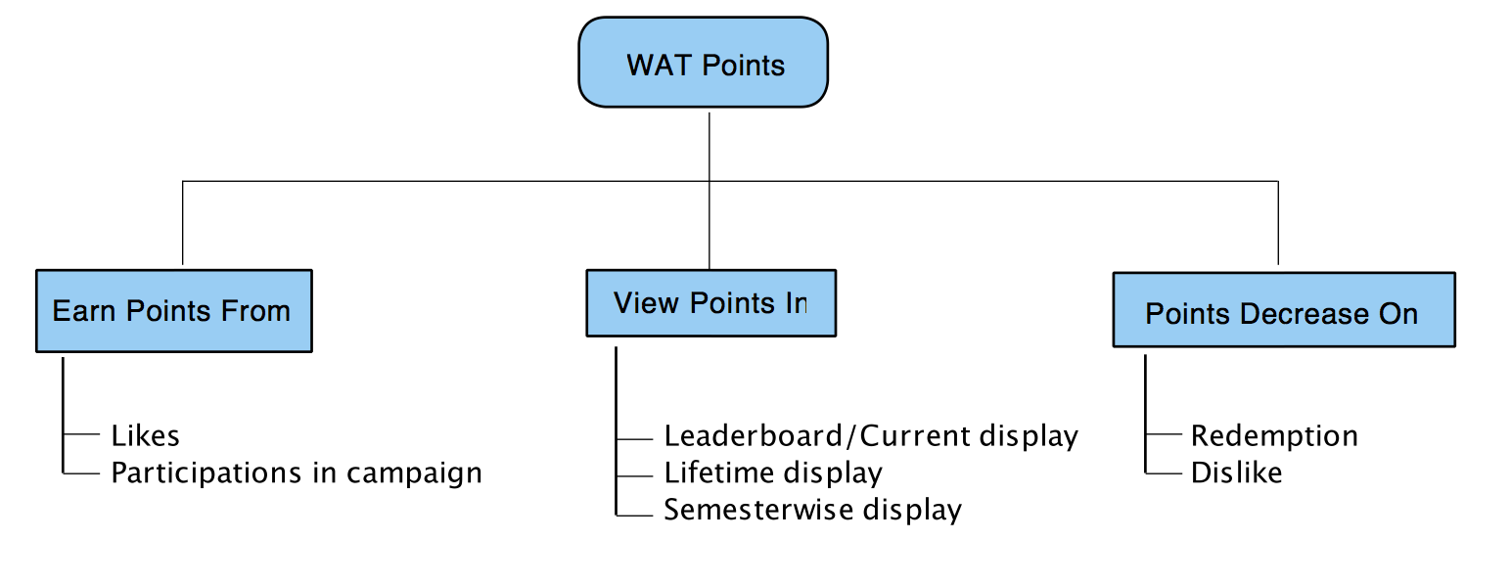
Work-Breakdown Structure Specific to “WAT” Points Functionality
@Copyright 2014
* But for gain and lose, it can be different for different point.
Notes:
Golf

Slide 16
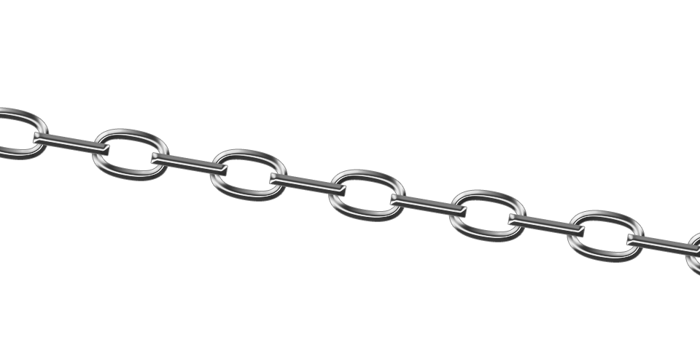
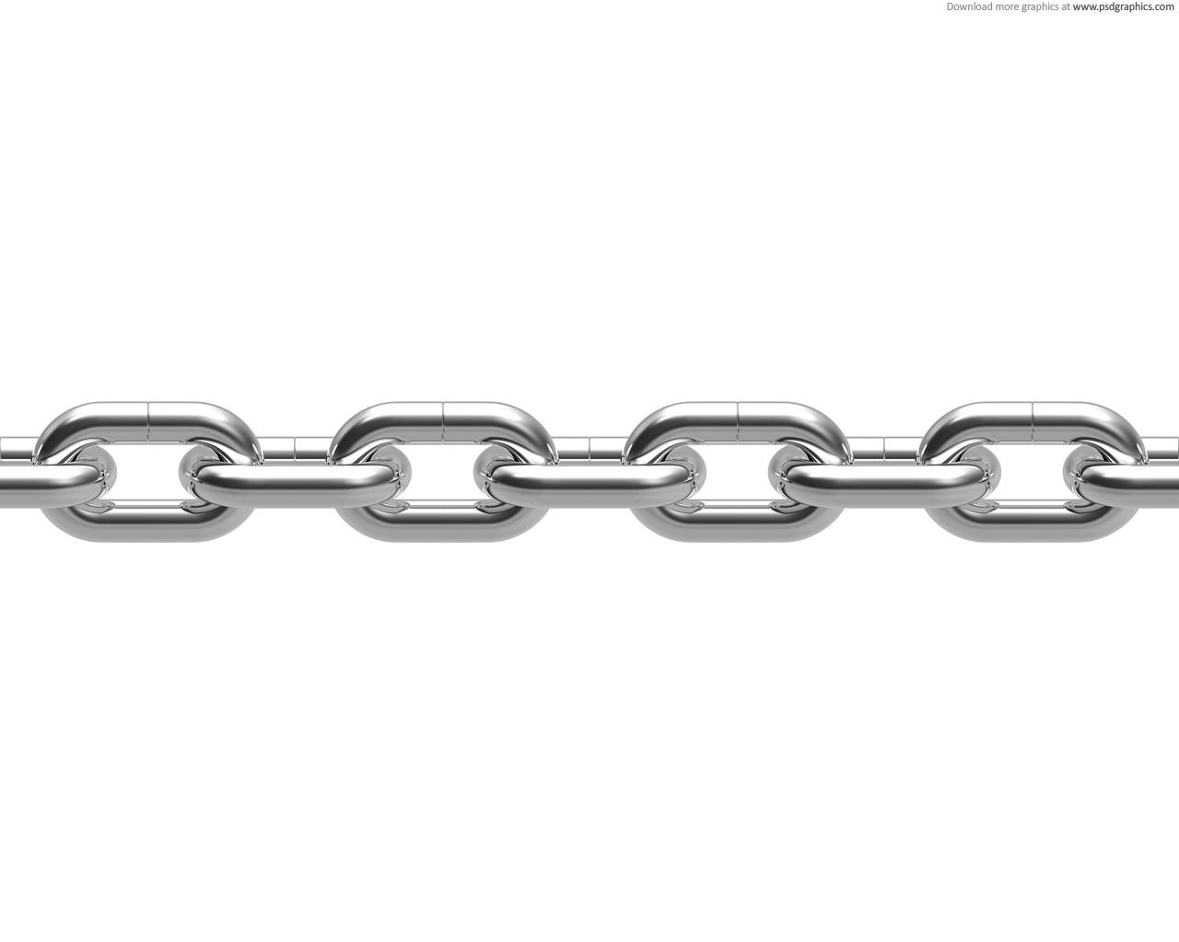
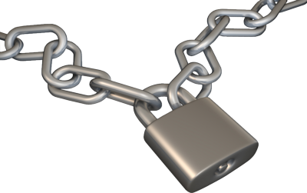
Problems with WAT Point System
How to keep track and sync three different types of WAT points for the like and dislike? (They could change at any time)
Each post can only contribute positively to a user’s points requirement which mean a post cannot give a negative point to a user even though the total points of dislike is greater than those of like. (Assume 1 like = 1 points, 1 dislike = -1 point).
If a user uses all of his usable points to redeem something (so usable point will be 0), what will happen when his post get a dislike? Will his usable points become negative?
@Copyright 2014
Notes:
Nam
you may notice that WAT point system is very complex
and there are several problems with WAT point
that is
how to keep track and sync three diff types of WAT points
our requirement is each post can only contribute positively to a user’s point
and if a user uses all of his usable points -> what will happen when his post get a dislike
(that mean user may be able to cheat our system)
Image From: http://www.officialpsds.com/images/thumbs/chain-and-lock-psd42356.png

Slide 17
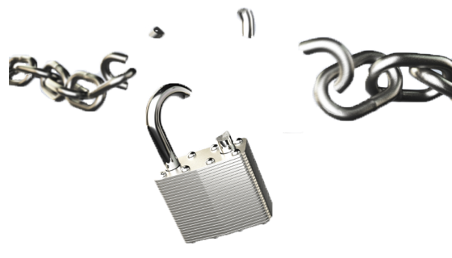

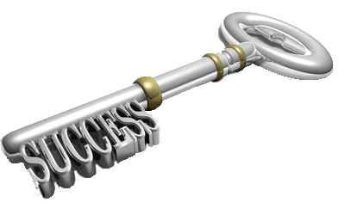
Our current solution to the problems
NL = Number of Like
ND = Number of Dislike
LV = Like Value
DV = Dislike Value
@Copyright 2014
A Monthly Usable Point update Approach
A Monthly Update Mechanism
Notes:
Nam
solution is
we come up with an equation to calculate post’s point
to solve post’s point can only contribute positively problem and syncing three point problem.
in sum we calculate like point and dislike point of a post and if like point have higher value then the different is is post’s point
if the dislike point have higher value then the post point is zero
another solution is a monthly usable point update approach to solve the cheating problem
Image From: http://www.bethgolden.com/wp-content/uploads/2011/02/Key-to-Success.png

Slide 18
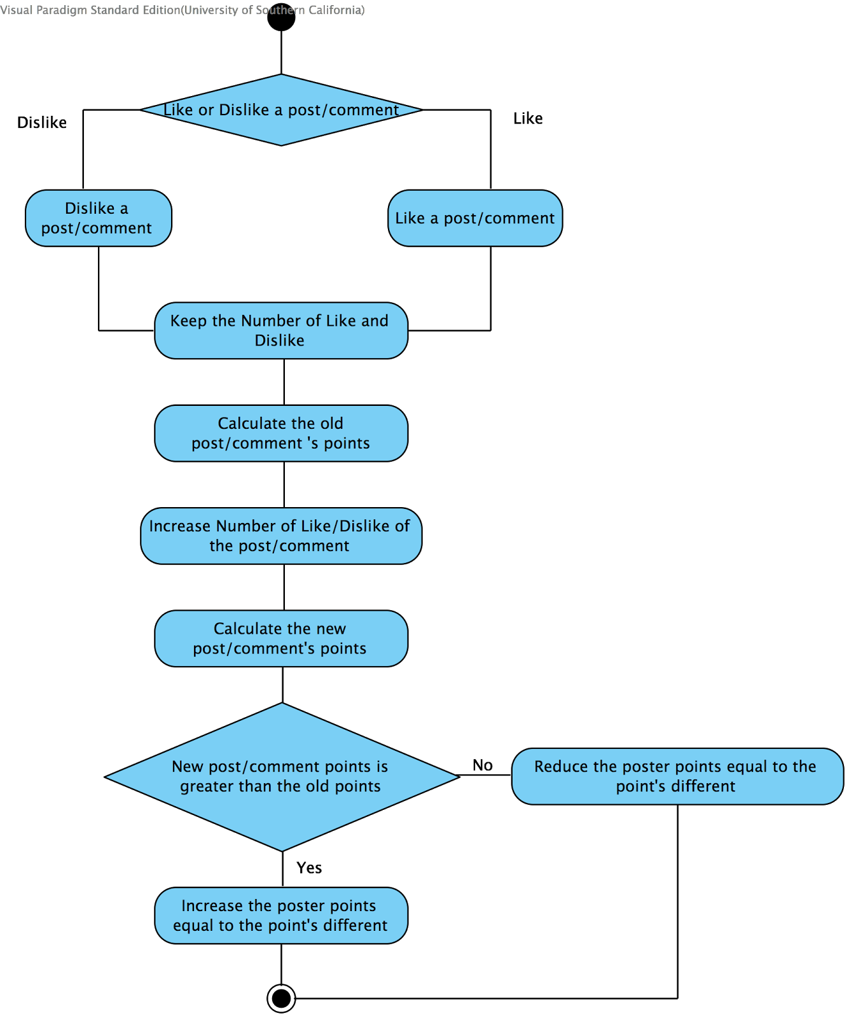
Algorithmic Flow-Chart:
@Copyright 2014
Notes:
Nam
because we do not want to calculate post’s point every time we have to show the data
so we cache the user point in our database
and use this algorithmic flow-chart to calculate and update our database to keep the user point in sync
---------------------
then we sync user point to each like/dislike event by follow this flow-chart
when some user click like/dislike to a post
our system will
1 new like : 10 old like and 2 old dislike
firstly we calculate the old post’s point: 10*1 - 2*1 = 8(old post’s point)
then we add the new like: 11 like and 2 dislike
then calculate new post’s point: 11*1 - 2*1 = 9(new post’s point)
then we compare the different of the new and old post’s point
and add the point to the user if the new one is greater
reduce the point of the user if the new one is lesser
we add the difference to the poster point if the new post point is greater
and we reduce the difference to the poster point if the new post point is lesser

Slide 19
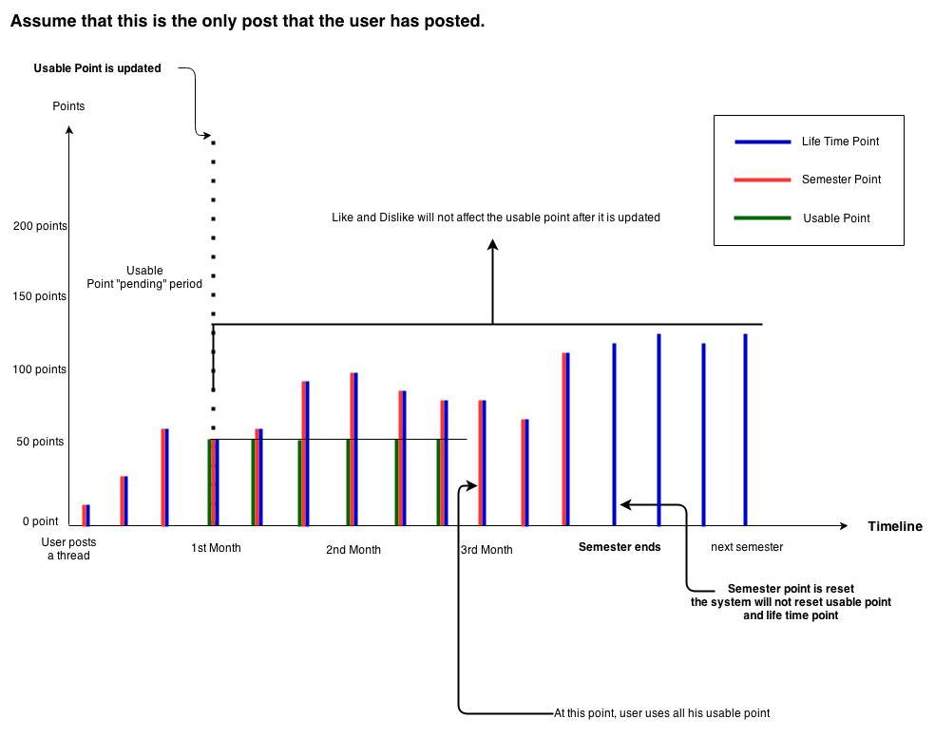
Prototype: WAT Point System Summary
@Copyright 2014
Notes:
Title

Slide 20

@Copyright 2014
Lessons Learned
Notes:
Eirik
Image from: https://www.livelingua.com/blog/think-about-the-children/

Slide 21
Lessons learned
Prototyping is useful for:
Get a common understanding of the requirements among stakeholders.
Resolve technical issues prior to development, and evaluate feasibility.
@Copyright 2014
Notes:
Eirik

Slide 22

@Copyright 2014
Next Steps
Notes:
Eirik
Image from: http://www.sosemarketing.com/2011/04/01/small-business-marketing-take-the-next-step-to-becoming-a-%E2%80%9Cmake-a-change-guy%E2%80%9D/

Slide 23

Next steps
User survey
Continue UI prototyping
Prototype search functionality
@Copyright 2014
Notes:
Eirik
High risk: competing websites, will users like our site, points system?
Image: http://info.furnitureconsignment.com/bid/104887/A-Survey-of-Surveys

Slide 24
Thank you for your time..
@Copyright 2014
Notes:
Title

Slide 25
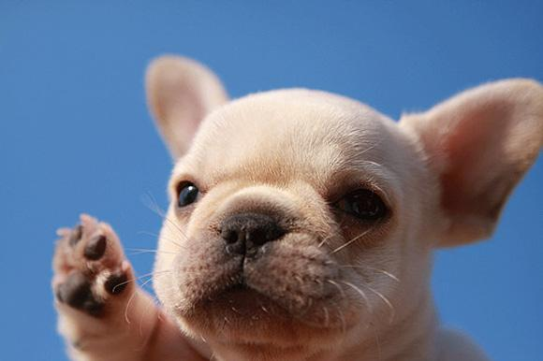
@Copyright 2014
We are ready for your questions..
Notes:
We will show this prototypes to the client and wait for their feedback. If you have any questions comments or concern, it’s time.
Image: http://www.cutestpaw.com/articles/best-of-the-week-cute-animal-pictures-8/

Slide 26
References
http://push-conference.com/2014/partners/
http://www.stepbystep.com/wp-content/uploads/2013/05/How-to-Evaluate-a-Software-Companys-Prototype.jpg
http://www.cutestpaw.com/articles/best-of-the-week-cute-animal-pictures-8/
http://www.sosemarketing.com/2011/04/01/small-business-marketing-take-the-next-step-to-becoming-a-%E2%80%9Cmake-a-change-guy%E2%80%9D/
https://www.livelingua.com/blog/think-about-the-children/
http://nonprofitanswerguide.org/ask/integrate-technology-into-nonprofit-and-tools-available/
http://icommakimberly.tumblr.com/post/37460885263/adorbs
@Copyright 2014

